Slide 1
Video game sales data and Analysis
MIS 502 Kushal Shah

Slide 2
Contents
Data Set Description
Data Preparation/Wrangling
Data Mining
Data Visualization

Slide 3
Data Set Description

Slide 4
Data Set Description
This dataset contains a list of video games with sales greater than 100,000 copies. It was generated by a scrape of vgchartz.com.
Fields include
Rank - Ranking of overall sales
Name - The games name
Platform - Platform of the games release (i.e. PC,PS4, etc.)
Year - Year of the game's release
Genre - Genre of the game
Publisher - Publisher of the game
NA_Sales - Sales in North America (in millions)
EU_Sales - Sales in Europe (in millions)
JP_Sales - Sales in Japan (in millions)
Other_Sales - Sales in the rest of the world (in millions)
Global_Sales - Total worldwide sales.

Slide 5
Data Set Description
We can use the data and analyze various things like
The games with the highest sales. The games with the lowest sales
We can explore the highest sales in which year
The top games for each platform
The top genres for games
The top game Publishers
The top games in different genres
The bestselling games in the different regions
How the sales were affected in different years
The distribution of sales in different regions

Slide 6
Data Preparation/ Data Wrangling

Slide 7
Data Preparation/Wrangling
The data needs to be prepared
The Data might have incomplete rows and columns.
The data set had 2 incomplete records which were dropped in the initial dataset.
After that I realized there are some Nan values I the year 2016, so I used fillna to replace the NaN with the mean values.
I then dropped the rows with missing values to clean the data.
The shape of the data before the Preparation is 16598 by 11 and after the preparation is 16598 by 10

Slide 8
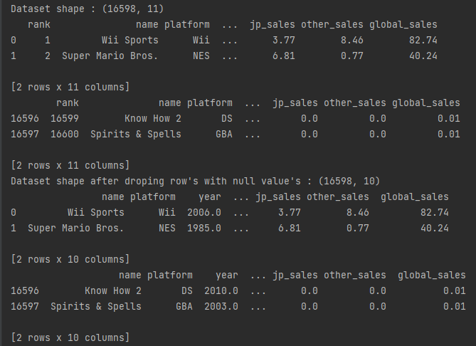
Data Preparation/Wrangling

Slide 9
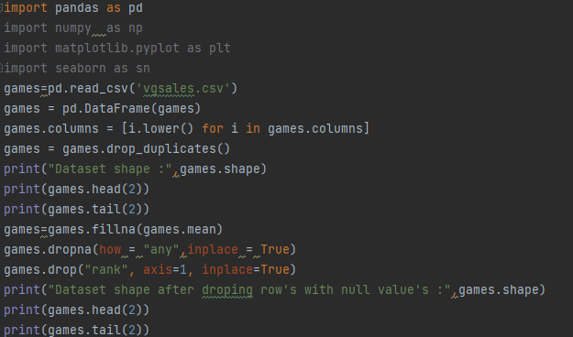
Data Preparation/Wrangling
The code for the data preparation I used

Slide 10
Data Mining

Slide 11
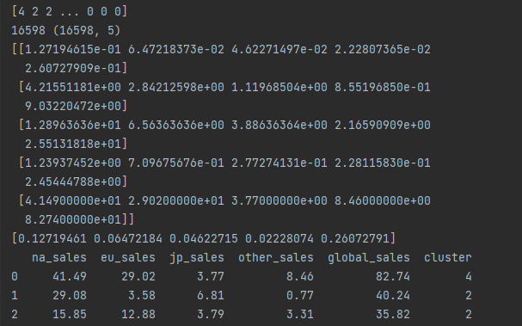
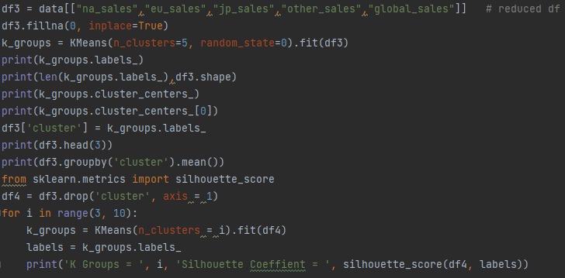
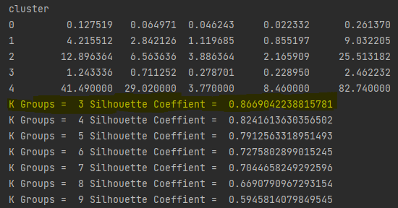
Cluster Analysis
Cluster Analysis
Results of Cluster Analysis

Slide 12
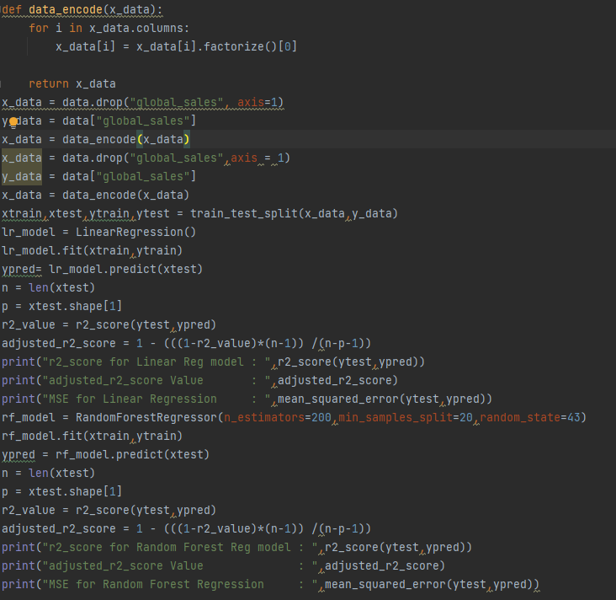
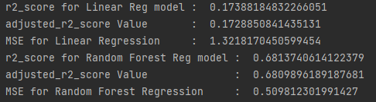
Linear and Random Forest Regression
Linear And Random Forest Regression
Results of Linear Regression and Random Forest regression

Slide 13
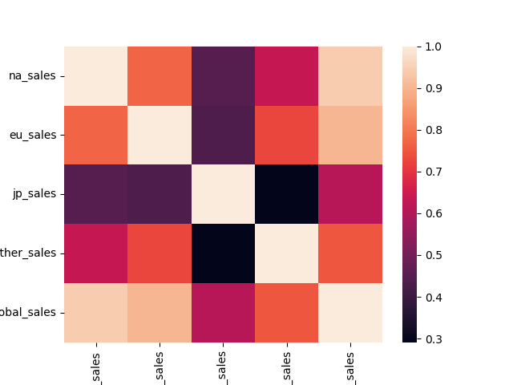
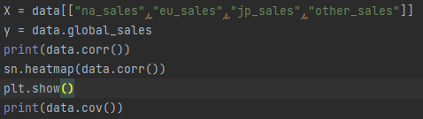
Association and Correlation
Association and Correlation
Results of Association and Correlation

Slide 14
Data Visualization

Slide 15
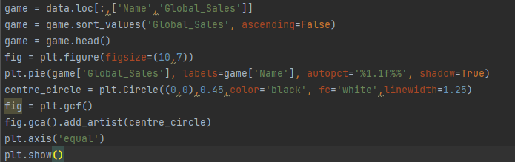
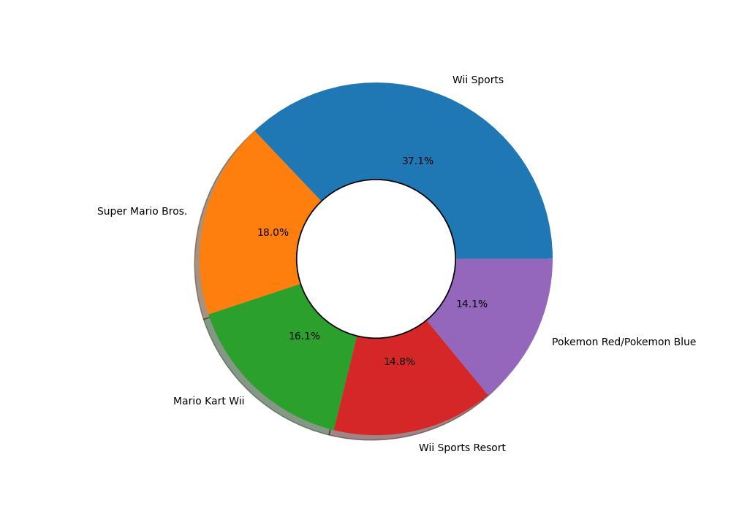
Which game has highest Global Sales? ----> Wii Sports

Slide 16

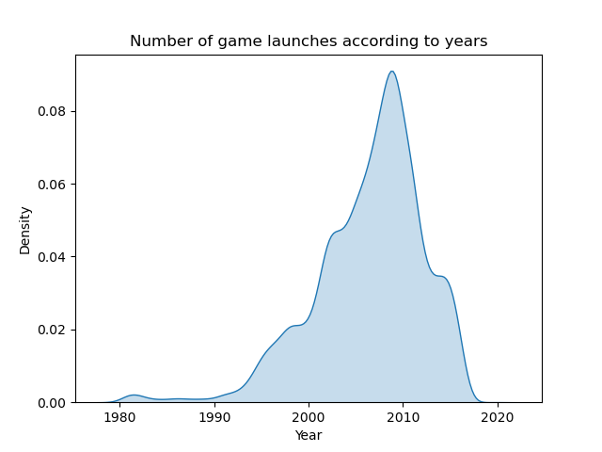
Game launches according to years

Slide 17

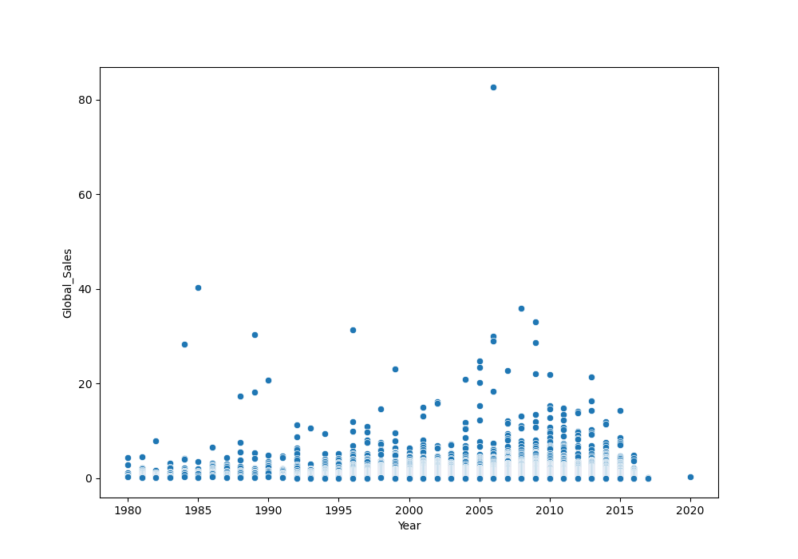
Relation of Global sales with years

Slide 18

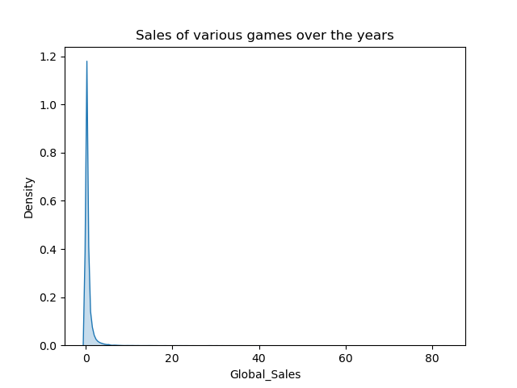
Sales range with most games

Slide 19
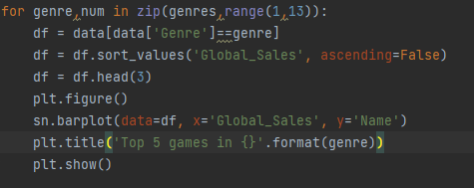
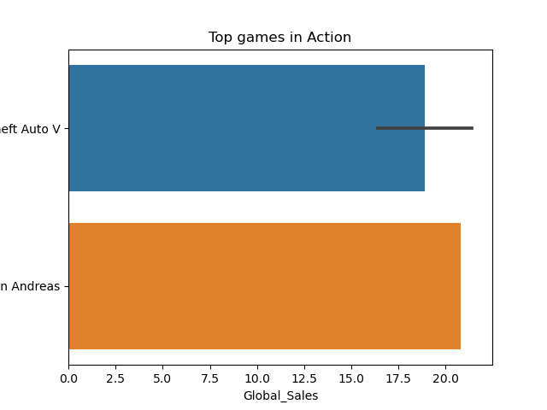
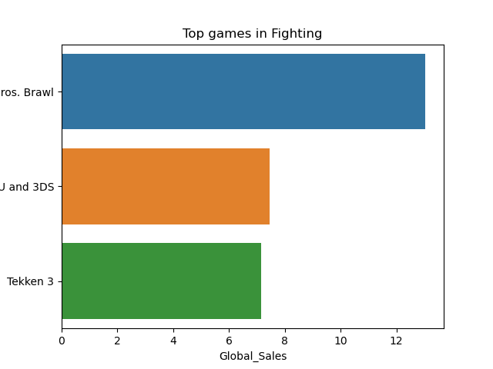
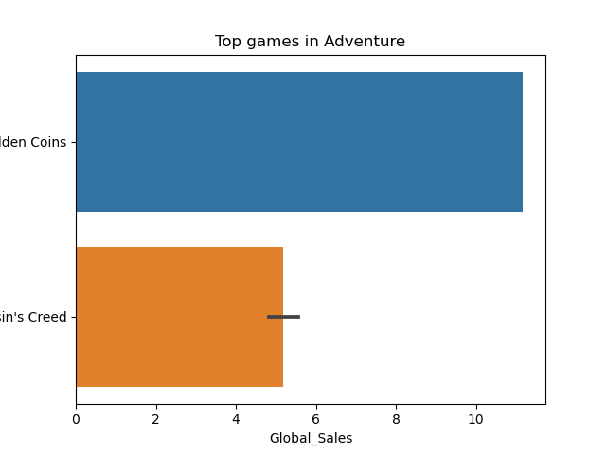
Top games in different genres

Slide 20
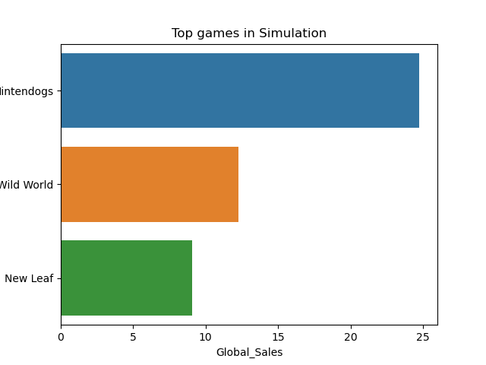
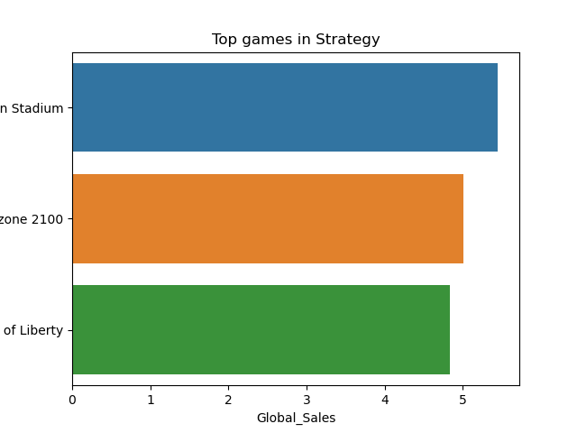
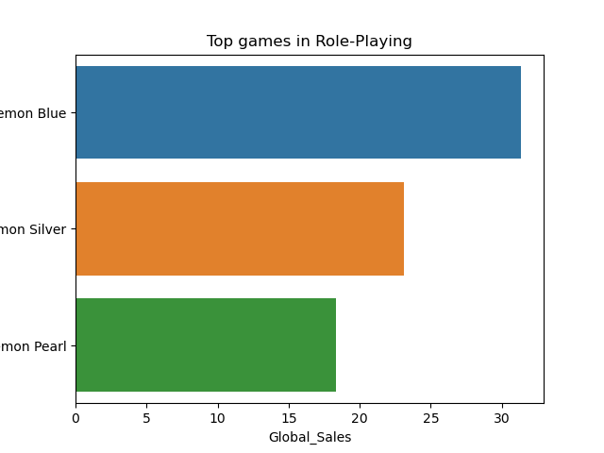
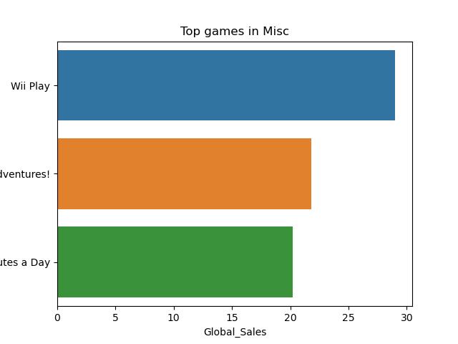

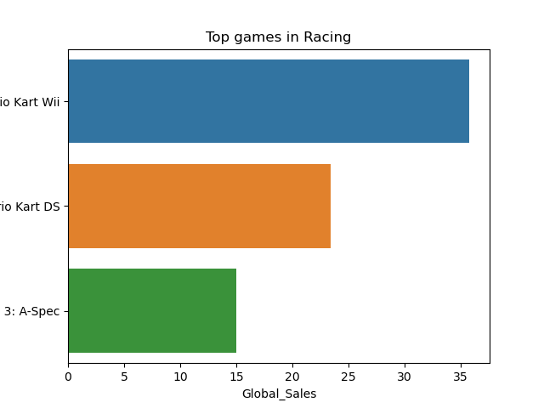
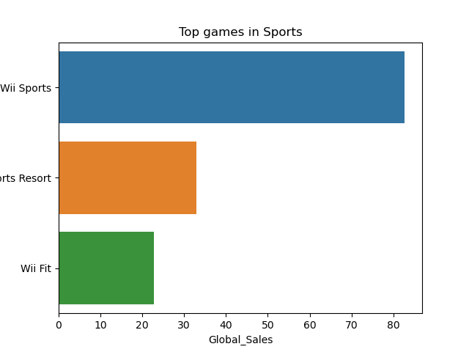
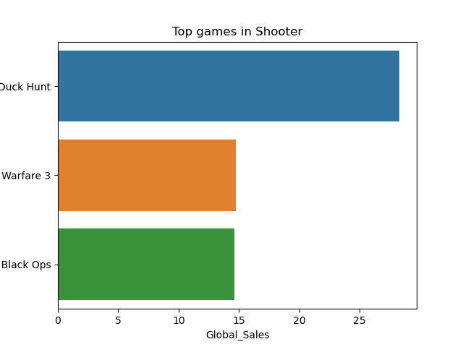
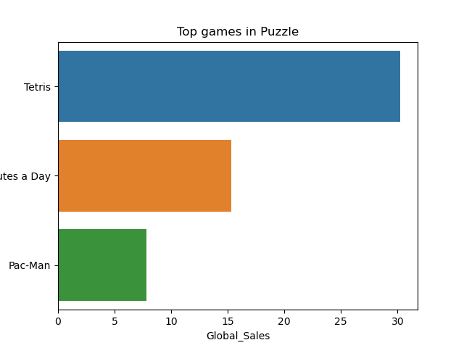
Top games in different genres

Slide 21
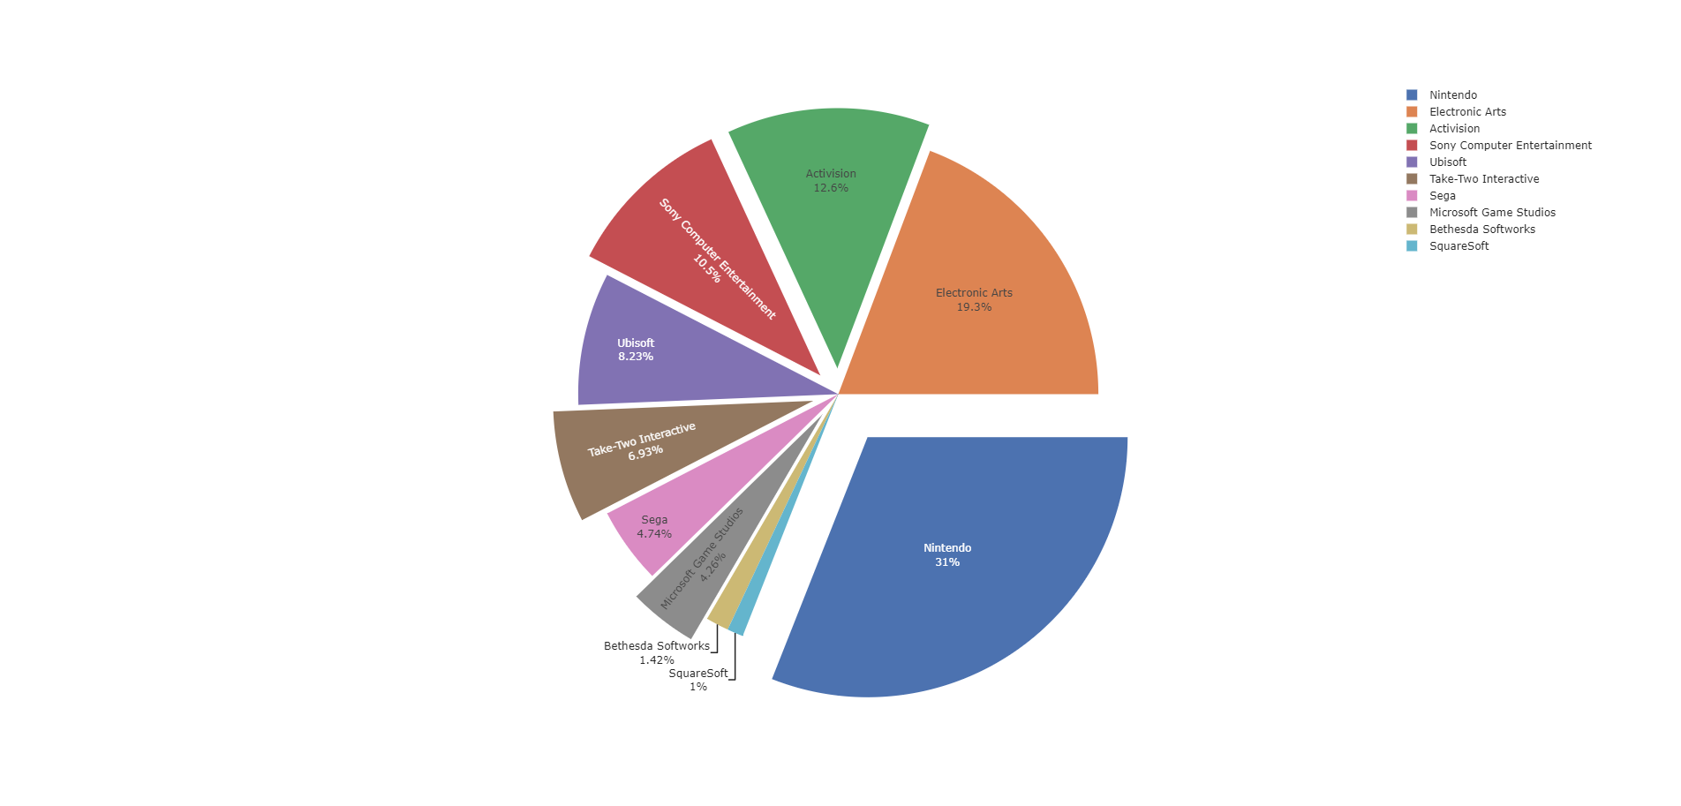
Top Publisher in terms of sales

Slide 22
Thank you
Kushal Shah

